Slide 1
Software Testing

Slide 2
Software Faults and Failures Why Does Software Fail?
Wrong requirement: not what the customer wants
Missing requirement
Requirement impossible to implement
Faulty design
Faulty code
Improperly implemented design

Slide 3

Objective of Testing
Objective of testing: discover faults
A test is successful only when a fault is discovered
Fault identification is the process of determining what fault caused the failure
Fault correction is the process of making changes to the system so that the faults are removed

Slide 4
Elements of a Test Case
Purpose
Input
Expected Output
Actual Output
Result
Sample Format:
Test Case ID | Purpose | Input Data | Expected Output | Actual Output | Result

Slide 5
Types of Faults
Algorithmic fault
Computation and precision fault
a formula’s implementation is wrong
Documentation fault
Documentation doesn’t match what program does
Capacity or boundary faults
System’s performance not acceptable when certain limits are reached
Timing or coordination faults
Performance faults
System does not perform at the speed prescribed

Slide 6
Software Faults and Failures Typical Algorithmic Faults
An algorithmic fault occurs when a component’s algorithm or logic does not produce proper output
Branching too soon
Branching too late
Forgetting to initialize variable or set loop invariants
Comparing variables of inappropriate data types

Slide 7
Different Levels of Failure Severity
Catastrophic: causes death or system loss
Critical: causes severe injury or major system damage
Marginal: causes minor injury or minor system damage
Minor: causes no injury or system damage
Very Low to Very High (or 1 to 5)
Very Very Low to Very Very High (or 1 to 7)
What about priority???

Slide 8
Software Testing?
Testing and Software Lifecycle
Traditional Process
Agile Process
DevOps?

Slide 9
Software Testing?
Lifecycle?
Uncover Faults??
Faults?
Test Case?
Structure (See slide 5)
Design (refer to slide 5 and the related class discussion)
Execution
Actual execution of code
Possible program failures, behavior and performance
Selection of finite test set

Slide 10
Views of Test Objects
White Box (Clear box): structure of the test objects
Control Flow
Basis Path, Branch, Statement, Decision…
Data Flow
Du Path, All-uses Path
Black Box (Closed box): functionality and performance of the test object
Equivalence classes, Boundary Value Analysis, Scenario-based, decision table based, state machine based…

Slide 11
Test Cases for Triangle Problem
Test cases based on input range
TC Id | What to test | A | B | C | EO
1 | EC1 of A | -10 | 15 | 15 | Value of A not in valid range
2 | EC1 of B | 15 | -10 | 15 | Value of B not in valid range
3 | EC1 of C | 15 | 15 | -10 | Value of C not in valid range
4 | EC3 of A | 205 | 15 | 15 | Value of A not in valid range
5 | EC3 of B | 15 | 205 | 15 | Value of B not in valid range
6 | EC3 of C | 15 | 15 | 205 | Value of C not in valid range
7 | EC2 of A, B, C | 15 | 15 | 15 | Equilateral
Note that we have made only one test case instead of three separate test cases to check ABC in valid range. This one test could be any test cases with any valid combination of A, B, C; for example see any of the valid range based test cases.
Test cases based on equivalence classes within valid range
TC Id | What to test | A | B | C | EO
1 | EC 1 | 15 | 15 | 15 | Equilateral
2 | EC 2 | 10 | 15 | 10 | Isosceles
3 | EC 3 | 5 | 6 | 7 | Scalene
4 | EC 4 | 1 | 2 | 10 | Not a triangle

Slide 12
Whitebox Testing Control Flow Graph
Statement testing
Branch testing
Path testing
…
Cyclomatic Complexity = E – N + 2 = 9 – 9 + 2 = 2

Slide 13
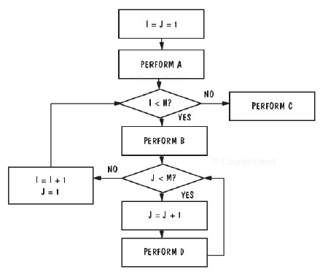
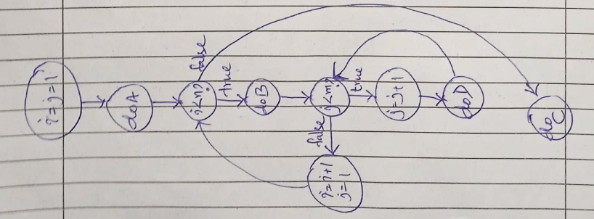
Example
How many paths?
MxN?
M?
N?
M=N=100,000?
Independent paths?
Cyclomatic Complexity

Slide 14
Levels of Testing
Module testing, component testing, or unit testing
Integration testing
System Testing
Function testing
Performance testing
Acceptance testing
Installation testing

Slide 15
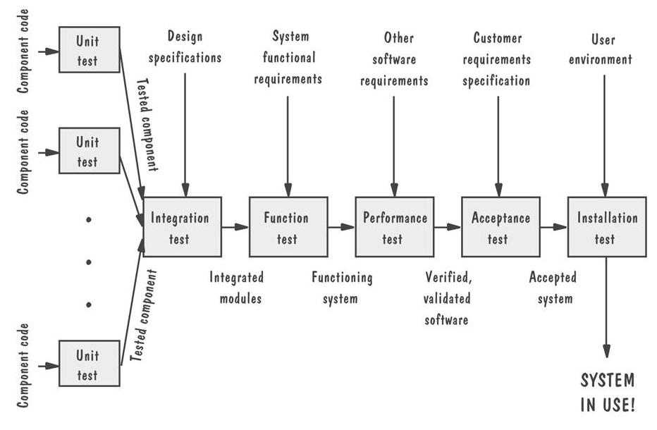
Levels of Testing Testing Organization Illustrated

Slide 16
Unit Testing Code Review
Code walkthrough
Code inspection

Slide 17
Unit Testing
Testing the unit for correct functionality
Testing the unit for correct execution

Slide 18
Unit Testing Steps in Testing
Determining test objectives
Selecting test cases
Executing test cases

Slide 19
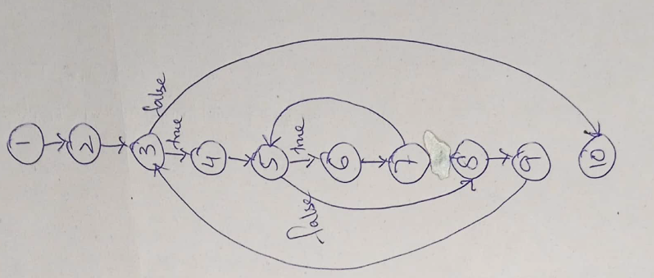
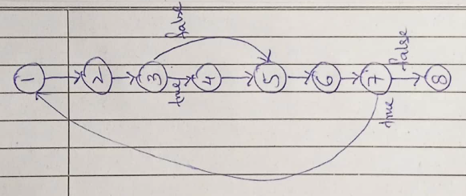
Unit Testing Whitebox Test Thoroughness
public static double calculateBill (int usage)
{
double bill = 0;
if(usage > 0)
{
bill = 40;
}
if(usage > 100)
{
if(usage <= 200)
{
bill = bill + (usage - 100) * 0.5;
}
else
{
bill = bill + 50 + (usage - 200) * 0.1;
if(bill >= 100)
{
bill = bill * 0.9;
}
}
}
return bill;
}
public static double calculateBill (int usage)
{
double bill = 0;
if(usage > 0)
{
bill = 40;
}
if(usage > 100)
{
if(usage >= 200)
{
bill = bill + (usage - 200) * 0.5;
}
bill = bill + 50 + (usage - 100) * 0.1;
}
return bill;
}
/*Line 1*/ i = 0;
/*Line 2*/ n=4;
/*Line 3*/ while (i<n-1) do
/*Line 4*/ j = i + 1;
/*Line 5*/ while (j<n) do
/*Line 6*/ if A[i]<A[j] then
/*Line 7*/ swap(A[i], A[j]);
/*Line 8*/ end do;
/*Line 9*/ i=i+1;
/*Line 10*/ end do;
Statement testing
Branch testing
Path testing
…
1do{
2 ptr = false
3 if(x>k)
4 ptr = true
5 x=x+1
6 result= f(x,ptr)
7}while (result≤0)
8print result

Slide 20
Exercise
/*Line 1*/ boolean isOutsideGrid(int x,int y,int xl, int yl){
/*Line 2*/ boolean isOutside = false;
/*Line 3*/ if (x<xl && y<yl)
/*Line 4*/ isOutside = true;
/*Line 5*/ return isOutside;
/*Line 6*/ }

Slide 21
System Testing
System is tested as a whole
Different types of testing considered during System Testing:
- Functional Testing (GUI) - Security
- Performance Testing - Sanity
- Usability - Smoke
- Load - Regression

Slide 22
Principles of System Testing Regression Testing
Identifies new faults that may have been introduced as current one are being corrected
Verifies a new version or release still performs the same functions in the same manner as an older version or release

Slide 23
Principles of System Testing Regression Testing Steps
Inserting the new code
Testing functions known to be affected by the new code
Testing essential function of m to verify that they still work properly
Continuing function testing m + 1
Test case priority?

Slide 24
Acceptance Tests Purpose and Roles
Enable the customers and users to determine if the built system meets their needs and expectations
Written, conducted and evaluated by the customers

Slide 25
Result of Acceptance Tests
List of requirements that
are not satisfied
must be deleted
must be revised
must be added

Slide 26
Installation Testing
Before the testing
Configure the system
Attach proper number and kind of devices
Establish communication with other system
The testing
Regression tests: to verify that the system has been installed properly and works
Test case priority???

Slide 27
Software Testing Tools
Automated Testing Tools
Selenium, QTP, SilkTest, WinRunner, LoadRunner, Jmeter
Testing Management Tools
TestManager, TestDirector
Bug Tracking/Configuration Management Tools
Bugzilla, Jitterbug, SilkRadar

Slide 28
References
UCF Slides
Software Testing, A Craftsman’s Approach by Jorgensen

